Slide 1
CS162 Operating Systems and Systems Programming Lecture 12 Scheduling 3: Case Studies (Con’t), Realtime, Starvation, Deadlock
February 28th, 2023
Prof. John Kubiatowicz
http://cs162.eecs.Berkeley.edu

Slide 2
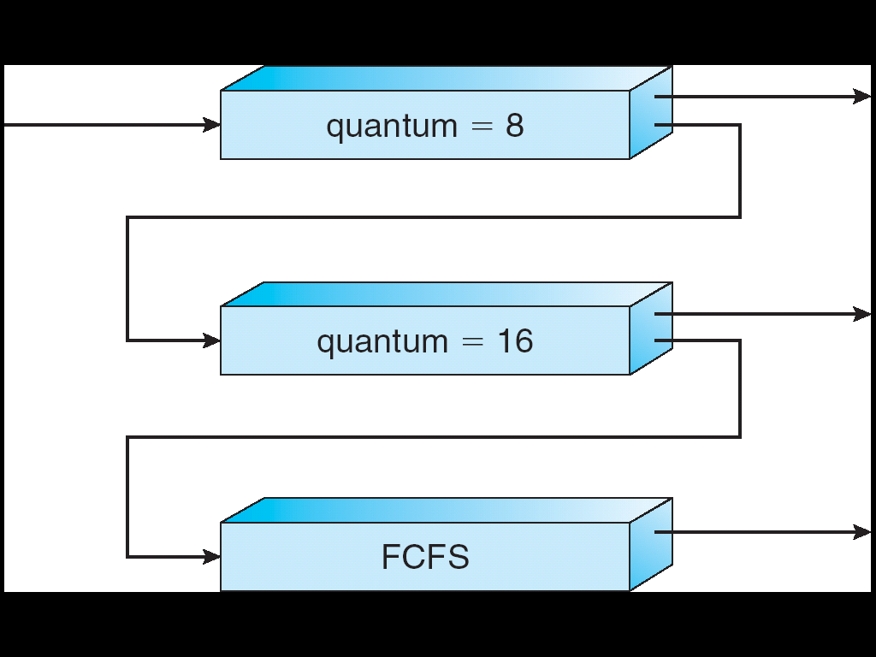
Recall: Multi-Level Feedback Scheduling
Another method for exploiting past behavior (first use in CTSS)
Multiple queues, each with different priority
Higher priority queues often considered “foreground” tasks
Each queue has its own scheduling algorithm
e.g. foreground – RR, background – FCFS
Sometimes multiple RR priorities with quantum increasing exponentially (highest:1ms, next: 2ms, next: 4ms, etc)
Adjust each job’s priority as follows (details vary)
Job starts in highest priority queue
If timeout expires, drop one level
If timeout doesn’t expire, push up one level (or to top)
Long-Running Compute Tasks Demoted to Low Priority

Slide 3
Recall: Case Study: Linux O(1) Scheduler
Kernel/Realtime Tasks
User Tasks
0
100
139
Priority-based scheduler: 140 priorities
40 for “user tasks” (set by “nice”), 100 for “Realtime/Kernel”
Lower priority value ⇒ higher priority (for realtime values)
Highest priority value ⇒ Lower priority (for nice values)
All algorithms O(1)
Timeslices/priorities/interactivity credits all computed when job finishes time slice
140-bit bit mask indicates presence or absence of job at given priority level
Two separate priority queues: “active” and “expired”
All tasks in the active queue use up their timeslices and get placed on the expired queue, after which queues swapped
Timeslice depends on priority – linearly mapped onto timeslice range
Like a multi-level queue (one queue per priority) with different timeslice at each level
Execution split into “Timeslice Granularity” chunks – round robin through priority

Slide 4
So, Does the OS Schedule Processes or Threads?
Many textbooks use the “old model”—one thread per process
Usually it's really: threads (e.g., in Linux)
One point to notice: switching threads vs. switching processes incurs different costs:
Switch threads: Save/restore registers
Switch processes: Change active address space too!
Expensive
Disrupts caching
Recall, However: Simultaneous Multithreading (or “Hyperthreading”)
Different threads interleaved on a cycle-by-cycle basis and can be in different processes (have different address spaces)

Slide 5
Multi-Core Scheduling
Algorithmically, not a huge difference from single-core scheduling
Implementation-wise, helpful to have per-core scheduling data structures
Cache coherence
Affinity scheduling: once a thread is scheduled on a CPU, OS tries to reschedule it on the same CPU
Cache reuse

Slide 6
Recall: Spinlocks for multiprocessing
Spinlock implementation:
int value = 0; // Free
Acquire() { while (test&set(&value)) {}; // spin while busy }
Release() { value = 0; // atomic store }
Spinlock doesn’t put the calling thread to sleep—it just busy waits
When might this be preferable?
Waiting for limited number of threads at a barrier in a multiprocessing (multicore) program
Wait time at barrier would be greatly increased if threads must be woken inside kernel
Every test&set() is a write, which makes value ping-pong around between core-local caches (using lots of memory!)
So – really want to use test&test&set() !
As we discussed in Lecture 8, the extra read eliminates the ping-ponging issues:
// Implementation of test&test&set(): Acquire() { do { while(value); // wait until might be free } while (test&set(&value)); // exit if acquire lock }

Slide 7
Gang Scheduling and Parallel Applications
When multiple threads work together on a multi-core system, try to schedule them together
Makes spin-waiting more efficient (inefficient to spin-wait for a thread that’s suspended)
Alternative: OS informs a parallel program how many processors its threads are scheduled on (Scheduler Activations)
Application adapts to number of cores that it has scheduled
“Space sharing” with other parallel programs can be more efficient, because parallel speedup is often sublinear with the number of cores

Slide 8
Real-Time Scheduling
Goal: Predictability of Performance!
We need to predict with confidence worst case response times for systems!
In RTS, performance guarantees are:
Task- and/or class centric and often ensured a priori
In conventional systems, performance is:
System/throughput oriented with post-processing (… wait and see …)
Real-time is about enforcing predictability, and does not equal fast computing!!!
Hard real-time: for time-critical safety-oriented systems
Meet all deadlines (if at all possible)
Ideally: determine in advance if this is possible
Earliest Deadline First (EDF), Least Laxity First (LLF), Rate-Monitonic Scheduling (RMS), Deadline Monotonic Scheduling (DM)
Soft real-time: for multimedia
Attempt to meet deadlines with high probability
Constant Bandwidth Server (CBS)

Slide 9
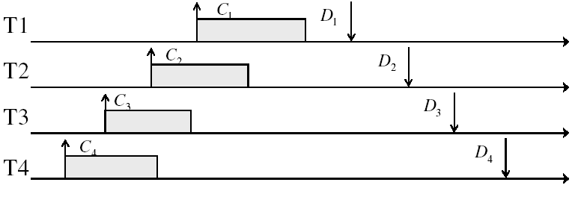
Example: Workload Characteristics
Tasks are preemptable, independent with arbitrary arrival (=release) times
Tasks have deadlines (D) and known computation times (C)
Example Setup:

Slide 10
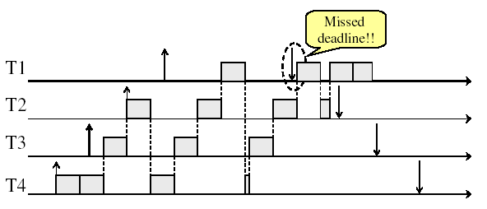
Example: Round-Robin Scheduling Doesn’t Work
Time

Slide 11

Earliest Deadline First (EDF)
Tasks periodic with period P and computation C in each period: ($P_{i}$, $C_{i}$) for each task $i$
Preemptive priority-based dynamic scheduling:
Each task is assigned a (current) priority based on how close the absolute deadline is (i.e. $D_{i}^{t+1}=D_{i}^{t}+P_{i}$for each task!)
The scheduler always schedules the active task with the closest absolute deadline
0
5
10
15

Slide 12
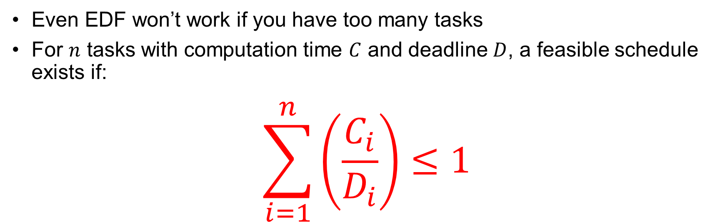
EDF Feasibility Testing
Even EDF won’t work if you have too many tasks
For $n$ tasks with computation time $C$ and deadline $D$, a feasible schedule exists if:
$$\sum_{i=1}^{n}{\left(\frac{C_{i}}{D_{i}}\right)}≤1$$

Slide 13
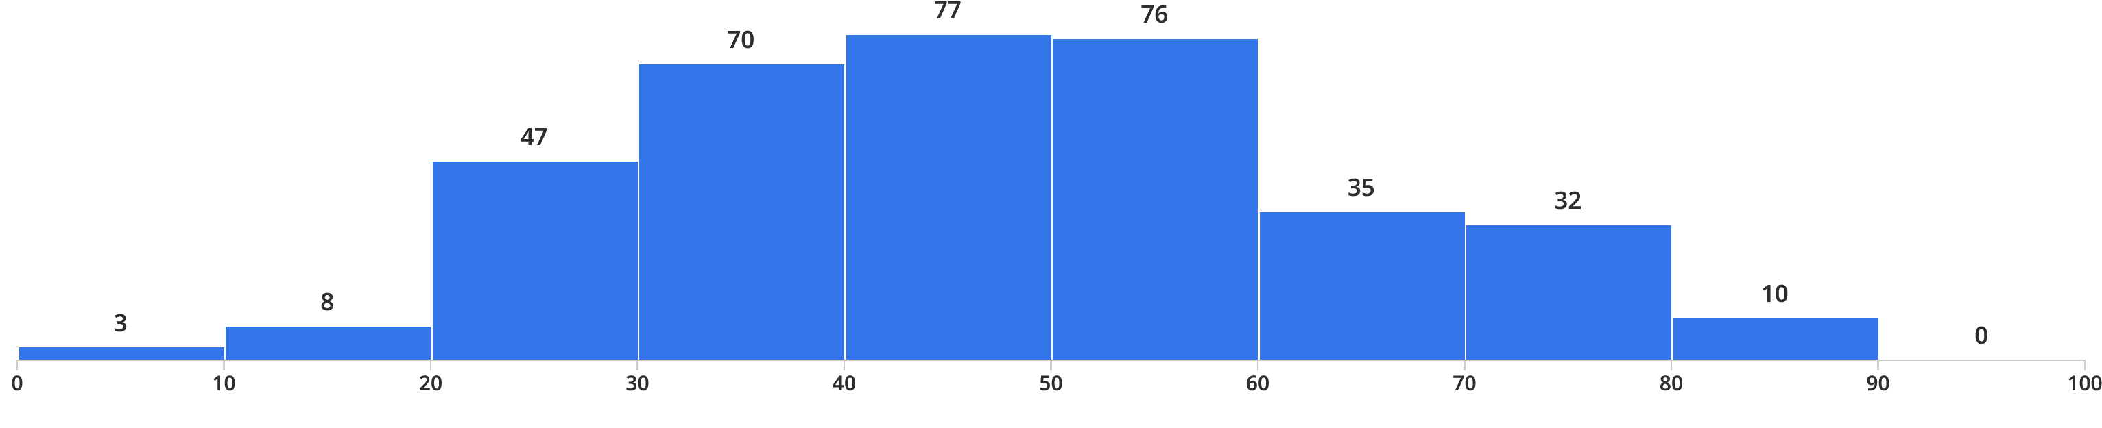
Administrivia
0
10
20
30
40
50
60
70
80
90
100
Midterm I results: Mean: 47.3, StdDev: 16.8, Min: 3.4, Max: 87.7
Yes, probably was too long!
Sorry about that!
Project 1 Extension:
Wednesday March 1st
Homework 3:
Due Tuesday 3/7
Can be done in Rust (if you want)

Slide 14
Ensuring Progress
Starvation: thread fails to make progress for an indefinite period of time
Starvation ≠ Deadlock because starvation could resolve under right circumstances
Deadlocks are unresolvable, cyclic requests for resources
Causes of starvation:
Scheduling policy never runs a particular thread on the CPU
Threads wait for each other or are spinning in a way that will never be resolved
Let’s explore what sorts of problems we might encounter and how to avoid them…

Slide 15
Strawman: Non-Work-Conserving Scheduler
A work-conserving scheduler is one that does not leave the CPU idle when there is work to do
A non-work-conserving scheduler could trivially lead to starvation
In this class, we’ll assume that the scheduler is work-conserving (unless stated otherwise)

Slide 16
Strawman: Last-Come, First-Served (LCFS)
Stack (LIFO) as a scheduling data structure
Late arrivals get fast service
Early ones wait – extremely unfair
In the worst case – starvation
When would this occur?
When arrival rate (offered load) exceeds service rate (delivered load)
Queue builds up faster than it drains
Queue can build in FIFO too, but “serviced in the order received”…

Slide 17
Is FCFS Prone to Starvation?
Scheduled Task (process, thread)
time
Scheduling Queue
arrivals
If a task never yields (e.g., goes into an infinite loop), then other tasks don’t get to run
Problem with all non-preemptive schedulers…
And early personal OSes such as original MacOS, Windows 3.1, etc

Slide 18
Is Round Robin (RR) Prone to Starvation?
Each of N processes gets ~1/N of CPU (in window)
With quantum length Q ms, process waits at most (N-1)*Q ms to run again
So a process can’t be kept waiting indefinitely
So RR is fair in terms of waiting time
Not necessarily in terms of throughput… (if you give up your time slot early, you don’t get the time back!)

Slide 19
Is Priority Scheduling Prone to Starvation?
Recall: Priority Scheduler always runs the thread with highest priority
Low priority thread might never run!
Starvation…
But there are more serious problems as well…
Priority inversion: even high priority threads might become starved
Priority 3
Job 1
Job 2
Job 3
Priority 2
Job 4
Priority 1
Priority 0
Job 5
Job 6
Job 7

Slide 20

Priority Inversion
Priority 3
Job 3
Priority 2
Job 2
Priority 1
Job 1
Acquire()
At this point, which job does the scheduler choose?
Job 3 (Highest priority)

Slide 21
Priority Inversion
Priority 3
Job 3
Acquire()
Priority 2
Job 2
Priority 1
Job 1
Job 3 attempts to acquire lock held by Job 1

Slide 22
Priority Inversion
Job 3
Blocked on Acquire
Priority 3
Priority 2
Job 2
Priority 1
Job 1
At this point, which job does the scheduler choose?
Job 2 (Medium Priority)
Priority Inversion

Slide 23
Priority Inversion
Where high priority task is blocked waiting on low priority task
Low priority one must run for high priority to make progress
Medium priority task can starve a high priority one
When else might priority lead to starvation or “live lock”?
High Priority
Low Priority
while (try_lock) {
…
}
lock.acquire(…)
…
lock.release(…)

Slide 24
One Solution: Priority Donation/Inheritance
Priority 3
Job 3
Acquire()
Priority 2
Job 2
Priority 1
Job 1
Job 3 temporarily grants Job 1 its “high priority” to run on its behalf

Slide 25
One Solution: Priority Donation/Inheritance
Job 3
Blocked on Acquire
Priority 3
Job 1
Release()
Priority 2
Job 2
Priority 1
Job 3 temporarily grants Job 1 its “high priority” to run on its behalf

Slide 26
One Solution: Priority Donation/Inheritance
Priority 3
Job 3
Acquire()
Priority 2
Job 2
Priority 1
Job 1
Project 2: Scheduling
Job 1 completes critical section and releases lock
Job 3 acquires lock, runs again
How does the scheduler know?

Slide 27

Case Study: Martian Pathfinder Rover
July 4, 1997 – Pathfinder lands on Mars
First US Mars landing since Vikings in 1976; first rover
Novel delivery mechanism: inside air-filled balloons bounced to stop on the surface from orbit!
And then…a few days into mission…:
Multiple system resets occur to realtime OS (VxWorks)
System would reboot randomly, losing valuable time and progress
Problem? Priority Inversion!
Low priority task grabs mutex trying to communicate with high priority task:
Realtime watchdog detected lack of forward progress and invoked reset to safe state
High-priority data distribution task was supposed to complete with regular deadline
Solution: Turn priority donation back on and upload fixes!
Original developers turned off priority donation (also called priority inheritance)
Worried about performance costs of donating priority!
Priority 2
Data Distribution Task: needs lock
Priority 1
Lots of random medium stuff
Priority 0
ASI/MET collector: grab lock

Slide 28
Are SRTF and MLFQ Prone to Starvation?
Long-Running Compute Tasks Demoted to Low Priority
In SRTF, long jobs are starved in favor of short ones
Same fundamental problem as priority scheduling
MLFQ is an approximation of SRTF, so it suffers from the same problem

Slide 29
Cause for Starvation: Priorities?
The policies we’ve studied so far:
Always prefer to give the CPU to a prioritized job
Non-prioritized jobs may never get to run
But priorities were a means, not an end
Our end goal was to serve a mix of CPU-bound, I/O bound, and Interactive jobs effectively on common hardware
Give the I/O bound ones enough CPU to issue their next file operation and wait (on those slow discs)
Give the interactive ones enough CPU to respond to an input and wait (on those slow humans)
Let the CPU bound ones grind away without too much disturbance

Slide 30
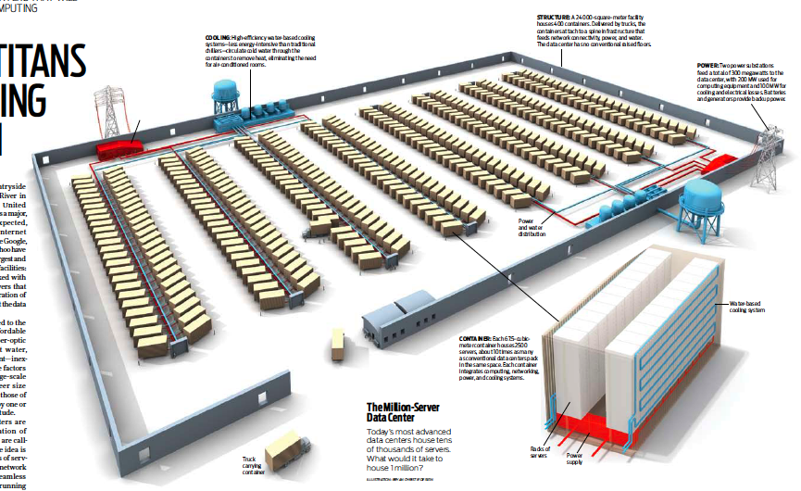
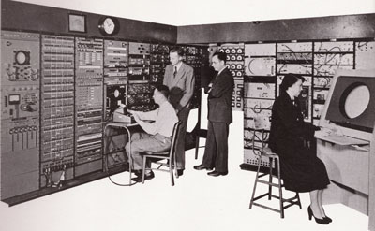
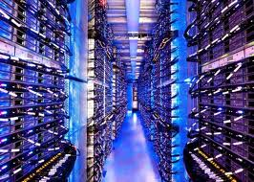
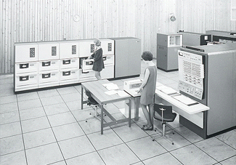
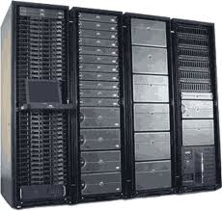
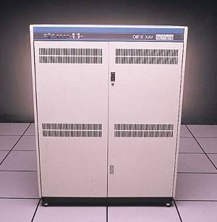
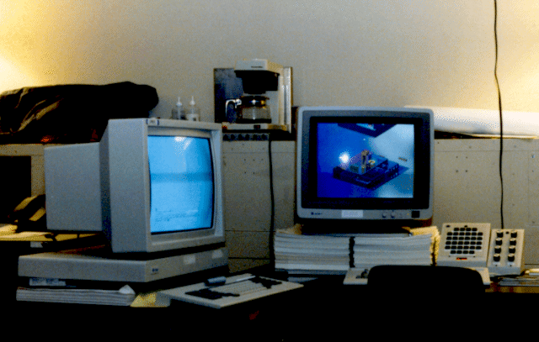







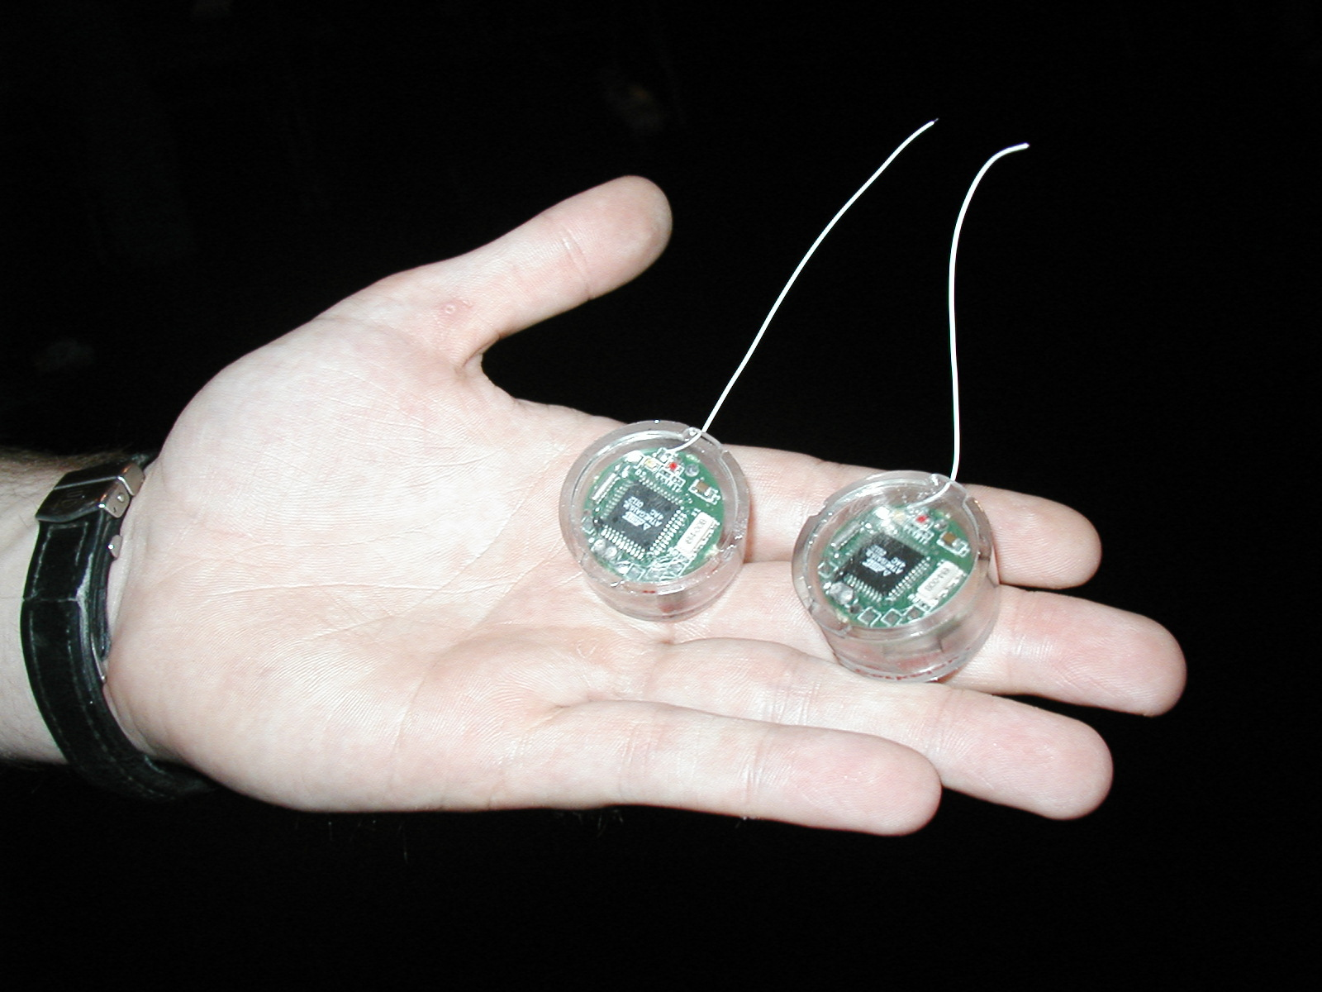
Recall: Changing Landscape…
Computers
Per Person
Number crunching, Data Storage, Massive Inet Services,
ML, …
1:10⁶
Mainframe
Bell’s Law: New computer class every 10 years
Mini
1:10³
Workstation
Productivity,
Interactive
PC
Laptop
1:1
PDA
Cell
Streaming from/to the physical world
10³:1
years
Mote!
The Internet of Things!

Slide 31
Changing Landscape of Scheduling
Priority-based scheduling rooted in “time-sharing”
Allocating precious, limited resources across a diverse workload
CPU bound, vs interactive, vs I/O bound
80’s brought about personal computers, workstations, and servers on networks
Different machines of different types for different purposes
Shift to fairness and avoiding extremes (starvation)
90’s emergence of the web, rise of internet-based services, the data-center-is-the-computer
Server consolidation, massive clustered services, huge flashcrowds
It’s about predictability, 95th percentile performance guarantees

Slide 32
Does prioritizing some jobs necessarily starve those that aren’t prioritized?

Slide 33
Key Idea: Proportional-Share Scheduling
The policies we’ve studied so far:
Always prefer to give the CPU to a prioritized job
Non-prioritized jobs may never get to run
Instead, we can share the CPU proportionally
Give each job a share of the CPU according to its priority
Low-priority jobs get to run less often
But all jobs can at least make progress (no starvation)

Slide 34
Recall: Lottery Scheduling
Q _{i}
Q _{i+1}
time
Given a set of jobs (the mix), provide each with a share of a resource
e.g., 50% of the CPU for Job A, 30% for Job B, and 20% for Job C
Idea: Give out tickets according to the proportion each should receive,
Every quantum (tick): draw one at random, schedule that job (thread) to run

Slide 35
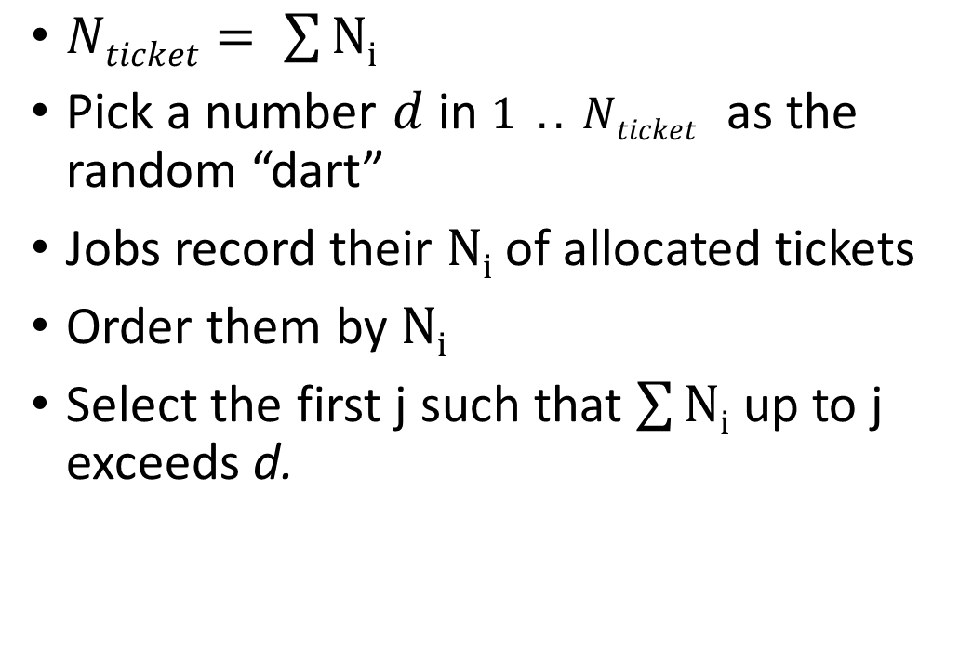
Lottery Scheduling: Simple Mechanism
10
$Nticket= \sum{Ni}$
Pick a number $d$ in $1 .. Nticket$ as the random “dart”
Jobs record their $Ni$ of allocated tickets
Order them by $Ni$
Select the first j such that $\sum{Ni}$ up to j exceeds d.
1

Slide 36
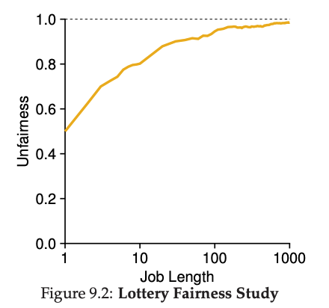
Unfairness
E.g., Given two jobs A and B of same run time (# Qs) that are each supposed to receive 50%,
U = finish time of first / finish time of last
As a function of run time

Slide 37
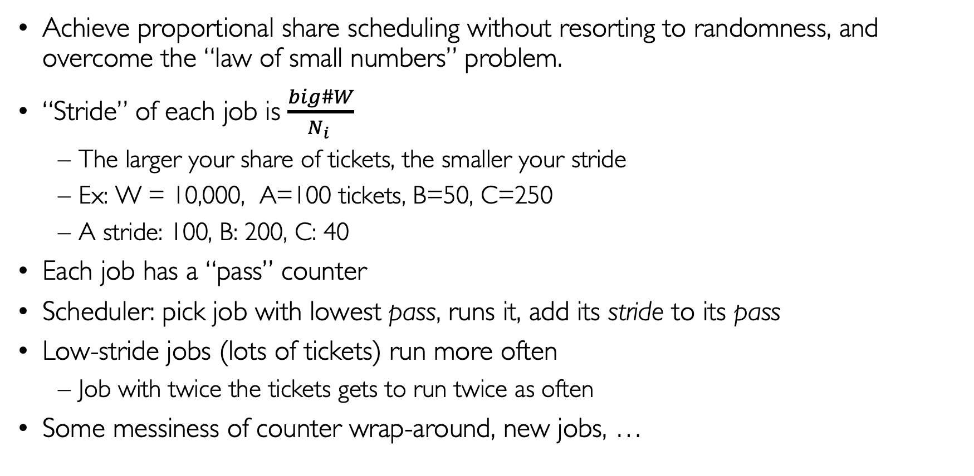
Stride Scheduling
Achieve proportional share scheduling without resorting to randomness, and overcome the “law of small numbers” problem.
“Stride” of each job is $\frac{big\#W}{N_{i} }$
The larger your share of tickets, the smaller your stride
Ex: W = 10,000, A=100 tickets, B=50, C=250
A stride: 100, B: 200, C: 40
Each job has a “pass” counter
Scheduler: pick job with lowest pass, runs it, add its stride to its pass
Low-stride jobs (lots of tickets) run more often
Job with twice the tickets gets to run twice as often
Some messiness of counter wrap-around, new jobs, …

Slide 38

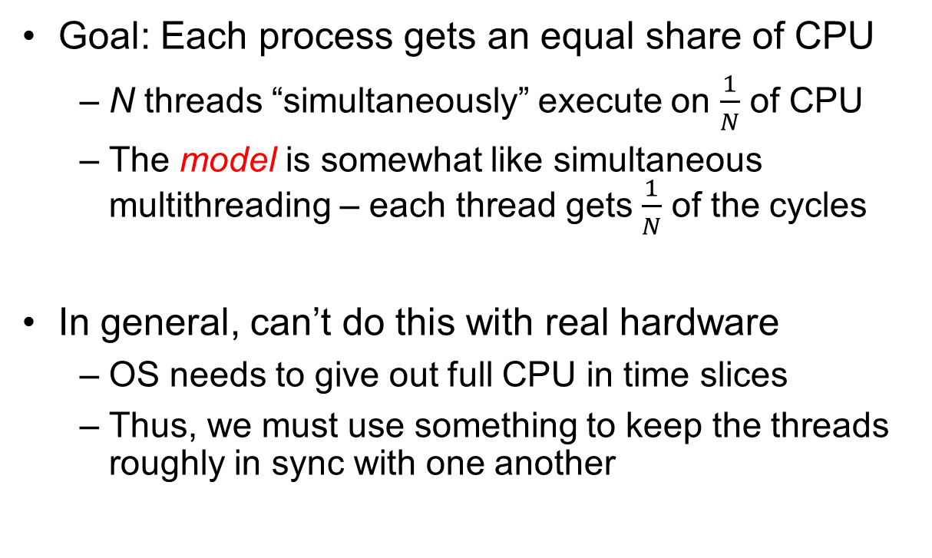
Linux Completely Fair Scheduler (CFS)
Goal: Each process gets an equal share of CPU
N threads “simultaneously” execute on $\frac{1}{N}$ of CPU
The model is somewhat like simultaneous multithreading – each thread gets $\frac{1}{N}$ of the cycles
In general, can’t do this with real hardware
OS needs to give out full CPU in time slices
Thus, we must use something to keep the threads roughly in sync with one another
Model: “Perfectly” subdivided CPU:
$$\frac{1}{N}$$
T₁
T₂
T₃
CPU Time

Slide 39
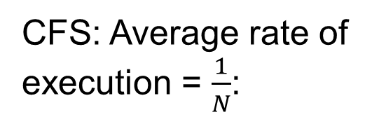

Linux Completely Fair Scheduler (CFS)
Basic Idea: track CPU time per thread and schedule threads to match up average rate of execution
Scheduling Decision:
“Repair” illusion of complete fairness
Choose thread with minimum CPU time
Closely related to Fair Queueing
Use a heap-like scheduling queue for this…
O(log N) to add/remove threads, where N is number of threads
Sleeping threads don’t advance their CPU time, so they get a boost when they wake up again…
Get interactivity automatically!
CFS: Average rate of execution = $\frac{1}{N}$:
T₁
$$\frac{1}{N}$$
T₃
CPU Time
T₂

Slide 40
Linux CFS: Responsiveness/Starvation Freedom
In addition to fairness, we want low response time and starvation freedom
Make sure that everyone gets to run at least a bit!
Constraint 1: Target Latency
Period of time over which every process gets service
Quanta = Target_Latency / n
Target Latency: 20 ms, 4 Processes
Each process gets 5ms time slice
Target Latency: 20 ms, 200 Processes
Each process gets 0.1ms time slice (!!!)
Recall Round-Robin: large context switching overhead if slice gets to small

Slide 41
Linux CFS: Throughput
Goal: Throughput
Avoid excessive overhead
Constraint 2: Minimum Granularity
Minimum length of any time slice
Target Latency 20 ms, Minimum Granularity 1 ms, 200 processes
Each process gets 1 ms time slice

Slide 42
Aside: Priority in Unix – Being Nice
The industrial operating systems of the 60s and 70’s provided priority to enforced desired usage policies.
When it was being developed at Berkeley, instead it provided ways to “be nice”.
nice values range from -20 to 19
Negative values are “not nice”
If you wanted to let your friends get more time, you would nice up your job
Scheduler puts higher nice-value tasks (lower priority) to sleep more …
In O(1) scheduler, this translated fairly directly to priority (and time slice)
How does this idea translate to CFS?
Change the rate of CPU cycles given to threads to change relative priority

Slide 43
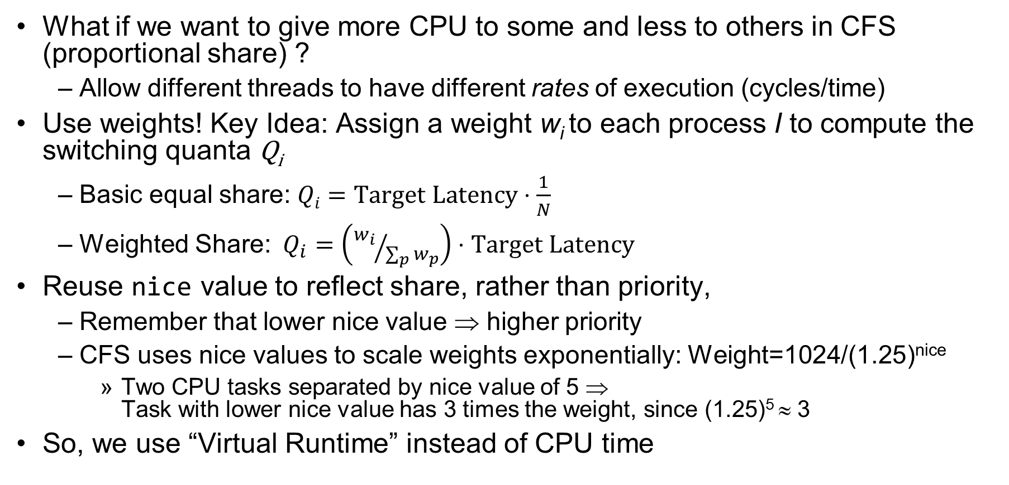
Linux CFS: Proportional Shares
What if we want to give more CPU to some and less to others in CFS (proportional share) ?
Allow different threads to have different rates of execution (cycles/time)
Use weights! Key Idea: Assign a weight w_{i} to each process I to compute the switching quanta Q_{i}
Basic equal share: $Qi=Target Latency⋅\frac{1}{N}$
Weighted Share:$Q_{i}=\left({w_{i}}/{\sum_{p}{w_{p}}}\right)⋅Target Latency$
Reuse nice value to reflect share, rather than priority,
Remember that lower nice value ⇒ higher priority
CFS uses nice values to scale weights exponentially: Weight=1024/(1.25)^{nice}
Two CPU tasks separated by nice value of 5 ⇒ Task with lower nice value has 3 times the weight, since (1.25)⁵ ≈ 3
So, we use “Virtual Runtime” instead of CPU time

Slide 44
Example: Linux CFS: Proportional Shares
Target Latency = 20ms
Minimum Granularity = 1ms
Example: Two CPU-Bound Threads
Thread A has weight 1
Thread B has weight 4
Time slice for A? 4 ms
Time slice for B? 16 ms

Slide 45
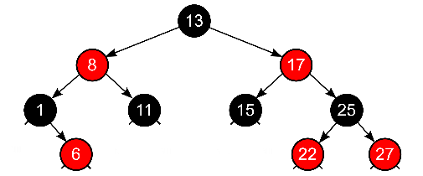
Linux CFS: Proportional Shares
16 (w_{B}=4)
B
Physical
CPU Time
Virtual
CPU Time
B
A
4 (w_{A}=1)
A
Track a thread's virtual runtime rather than its true physical runtime
Higher weight: Virtual runtime increases more slowly
Lower weight: Virtual runtime increases more quickly
Scheduler’s Decisions are based on Virtual CPU Time
Use of Red-Black tree to hold all runnable processes as sorted on vruntime variable
O(log N) time to perform insertions/deletions
Cache the item at far left (item with earliest vruntime)
When ready to schedule, grab version with smallest vruntime (which will be item at the far left).

Slide 46
Choosing the Right Scheduler
I Care About: | Then Choose:
CPU Throughput | FCFS
Avg. Response Time | SRTF Approximation
I/O Throughput | SRTF Approximation
Fairness (CPU Time) | Linux CFS
Fairness – Wait Time to Get CPU | Round Robin
Meeting Deadlines | EDF
Favoring Important Tasks | Priority

Slide 47
A Final Word On Scheduling
When do the details of the scheduling policy and fairness really matter?
When there aren’t enough resources to go around
When should you simply buy a faster computer?
(Or network link, or expanded highway, or …)
One approach: Buy it when it will pay for itself in improved response time
Perhaps you’re paying for worse response time in reduced productivity, customer angst, etc…
Might think that you should buy a faster X when X is utilized 100%, but usually, response time goes to infinity as utilization⇒100%
An interesting implication of this curve:
Most scheduling algorithms work fine in the “linear” portion of the load curve, fail otherwise
Argues for buying a faster X when hit “knee” of curve
Response
time
100%
Utilization

Slide 48
Deadlock: A Deadly type of Starvation
Starvation: thread waits indefinitely
Example, low-priority thread waiting for resources constantly in use by high-priority threads
Deadlock: circular waiting for resources
Thread A owns Res 1 and is waiting for Res 2 Thread B owns Res 2 and is waiting for Res 1
Deadlock ⇒ Starvation but not vice versa
Starvation can end (but doesn’t have to)
Deadlock can’t end without external intervention
Thread
A
Wait
For
Owned
By
Res 1
Res 2
Owned
By
Wait
For
Thread
B
Notes:
Now let's look at some key problems we face when synchronizing or scheduling concurrent tasks.

Slide 49
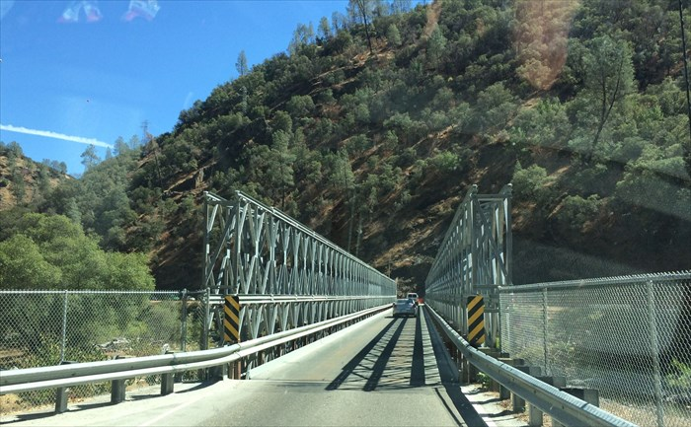
Example: Single-Lane Bridge Crossing
CA 140 to Yosemite National Park

Slide 50
Bridge Crossing Example
Each segment of road can be viewed as a resource
Car must own the segment under them
Must acquire segment that they are moving into
For bridge: must acquire both halves
Traffic only in one direction at a time
Deadlock: Shown above when two cars in opposite directions meet in middle
Each acquires one segment and needs next
Deadlock resolved if one car backs up (preempt resources and rollback)
Several cars may have to be backed up
Starvation (not Deadlock):
East-going traffic really fast ⇒ no one gets to go west
Owned
By
Wait
For
West Half
East Half
Honk!
Owned
By
Wait
For

Slide 51
Conclusion
Multi-Level Feedback Scheduling:
Multiple queues of different priorities and scheduling algorithms
Automatic promotion/demotion of process priority in order to approximate SJF/SRTF
Realtime Schedulers such as EDF
Guaranteed behavior by meeting deadlines
Realtime tasks defined by tuple of compute time and period
Schedulability test: is it possible to meet deadlines with proposed set of processes?
Lottery Scheduling:
Give each thread a priority-dependent number of tokens (short tasks⇒more tokens)
Linux CFS Scheduler: Fair fraction of CPU
Approximates an “ideal” multitasking processor
Practical example of “Fair Queueing”
Deadlock: circular waiting for resources
A form of starvation (indefinite stalling) that will never resolve

